Slide 1
Attribute/columns
Tuple/rows
Relation/table

Slide 2
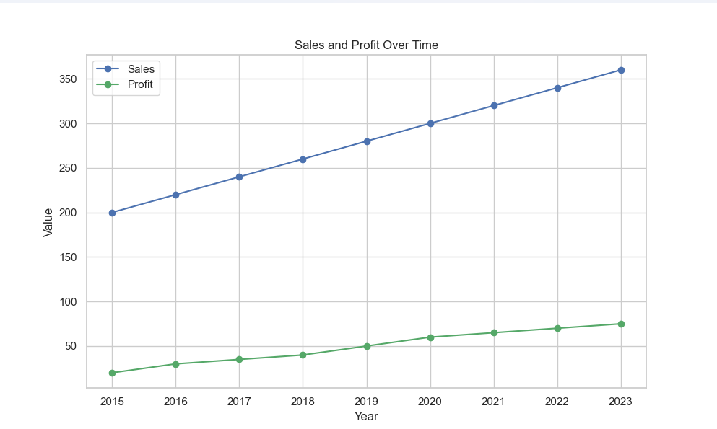
Legend
Marker
Label-y
Label-x

Slide 3
You
Old times
Database
Complex program
Its like a service. or you can say API database management system
Database application layer
Your program
Database
Complex program
Easy program
Transferred to database application
SQL -> used to interact with oracle databases
The complex program people wrote to access databases slowly turned into database applications
ORACLE (data management system)

Slide 4
User
Application Software
Database data server
(server that talks with data)
SQL
SQL
Oracle
Database Tools
Like oracle
Vocal conversation
Database
Aministrator

Slide 5
Order
Author
Attributes ▼
Attributes ▼
OrderID
OrderDate
ShippingAddress
quantity
Author ID
Name
Biography
Table Book (entity)
Relationships ▼
Relationships ▼
Writting (Book)
Book
Placed By (Customer)
item (Book)
Publisher
Attributes ▼
BookID
Title
ISBN
Publication Year
PublisherID
Attributes ▼
Publisher ID
Name
Address
Relationships ▼
Relationships ▼
Published (Book)
Purchased In (Order)
Written By (Author)
Published By (Publisher)
Customer
Attributes ▼
CustomerID
Name
Email
Address
Relationships ▼
Order (Order)

Slide 6
Artist
Production
Movie
Relation
Attributes ▼
Attributes ▼
ID
Name
Production_id
ID
Name
Attributes ▼
Primary Key
ID
Title
Rating
Length
playCount
Artist_id
Genre_id
Logical Key
Genre
Foreign Key
Attributes ▼
ID
Name
Naming foreign key Artist_id here is purely a convention for efficiency. You can even name it x or name of your dog
Different companies may have different conventions you have to adjust to them (like replacing ID with TableName_id , Id , TableNameID etc)

Slide 7
Student
TEACHER
Student
Student
Student
Student
ONE TO MANY
Student
TEACHER
many
One
That’s how we represent it

Slide 8
ONE TO MANY
TEACHER Table
name
ID
MANY
MISS Matsuzaka
1
Student Table
name
Teacher_ID
Student ID
Miss Yoshinaka
2
Shinchan
2
1
2
3
4
5
For One
Kazama
2
BO-chan
2
Cheetah
1
Hitoshi
1

Slide 9
Many TO MANY
Courses
Student
COURSES
STUDENTS
Junction table
So this makes it instead of one many to many relationship into two one to many relationships which we can handle easily
Courses
Junction
Students
Attributes ▼
Attributes ▼
Attributes ▼
ID
titile
Student_id
Course_id
ID
Name
email

Slide 10
ONE TO MANY
member Table
STUDENT_ID
COURSE_ID
Course Table
1 (Peepo)
1 (Peepo)
2 (Jenna)
3 (Einstein)
2 (Java)
3 (C++)
1 (Python)
1 (Python)
title
ID
Python
1
Java
2
C++
3
Student Table
Try to connect lines.
Peepo is a student of course Java and C++
ONE TO MANY
Jenna and Einstein are students of Python course
MANY TO ONE
TOGETHER FORM MANY TO MANY
name
ID
Peepo
1
Jenna
2
Einstein
3

